Slide 1
William Stallings Computer Organization and Architecture 6th Edition
Chapter 9
Computer Arithmetic

Slide 2
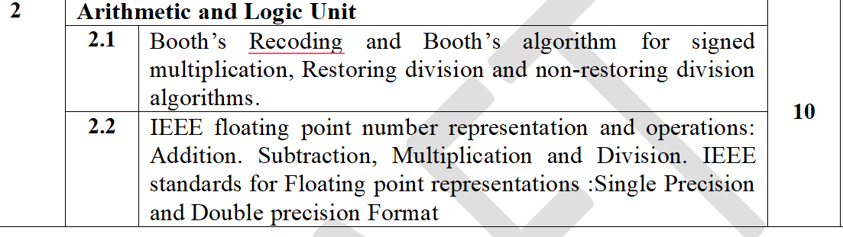

Slide 3
Arithmetic & Logic Unit
Does the calculations
Everything else in the computer is there to service this unit
Handles integers
May handle floating point (real) numbers
May be separate FPU (maths co-processor)

Slide 4
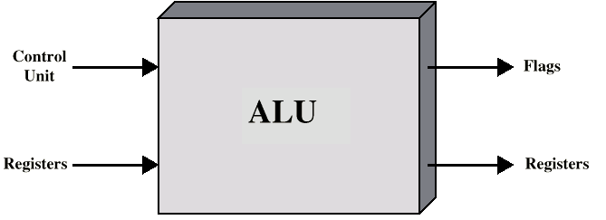
ALU Inputs and Outputs

Slide 5
Addition and Subtraction
Normal binary addition
Monitor sign bit for overflow
Take twos compliment of substahend and add to minuend
i.e. a - b = a + (-b)
So we only need addition and complement circuits

Slide 6
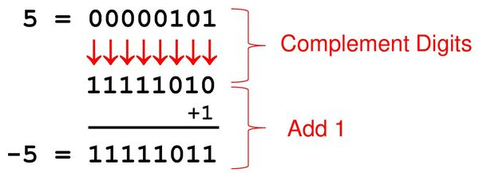
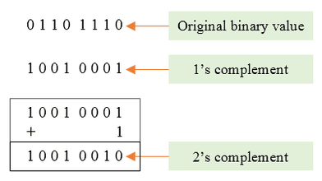
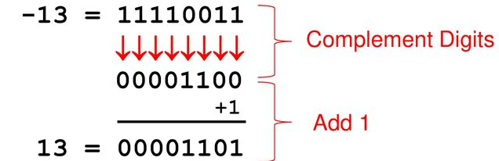
Example of 2’s Compliment

Slide 7
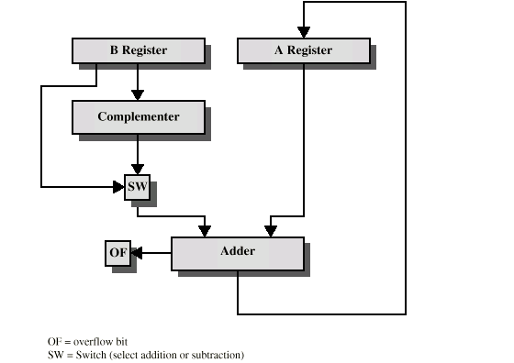
Hardware for Addition and Subtraction

Slide 8
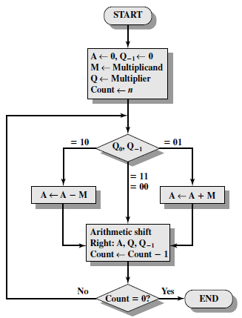
Booth’s Algorithm

Slide 9
M =7
Q =3
M = 0 1 1 1
Q = 0 0 1 1
- M = 1 0 0 1
Q0 | Q-1 | Result
0 | 0 | Only shift
1 | 1
0 | 1 | A=A + M ,then shift
1 | 0 | A= A – M , then shift

Slide 10
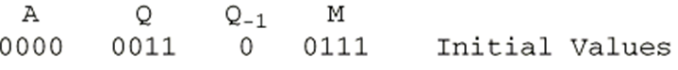
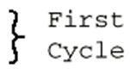
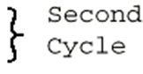
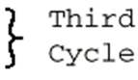
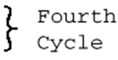
Example of Booth’s Algorithm:7(M)*3(Q)
Answer is in A and Q→0001 0101 =21

Slide 11
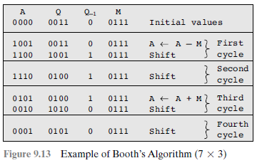

Slide 12
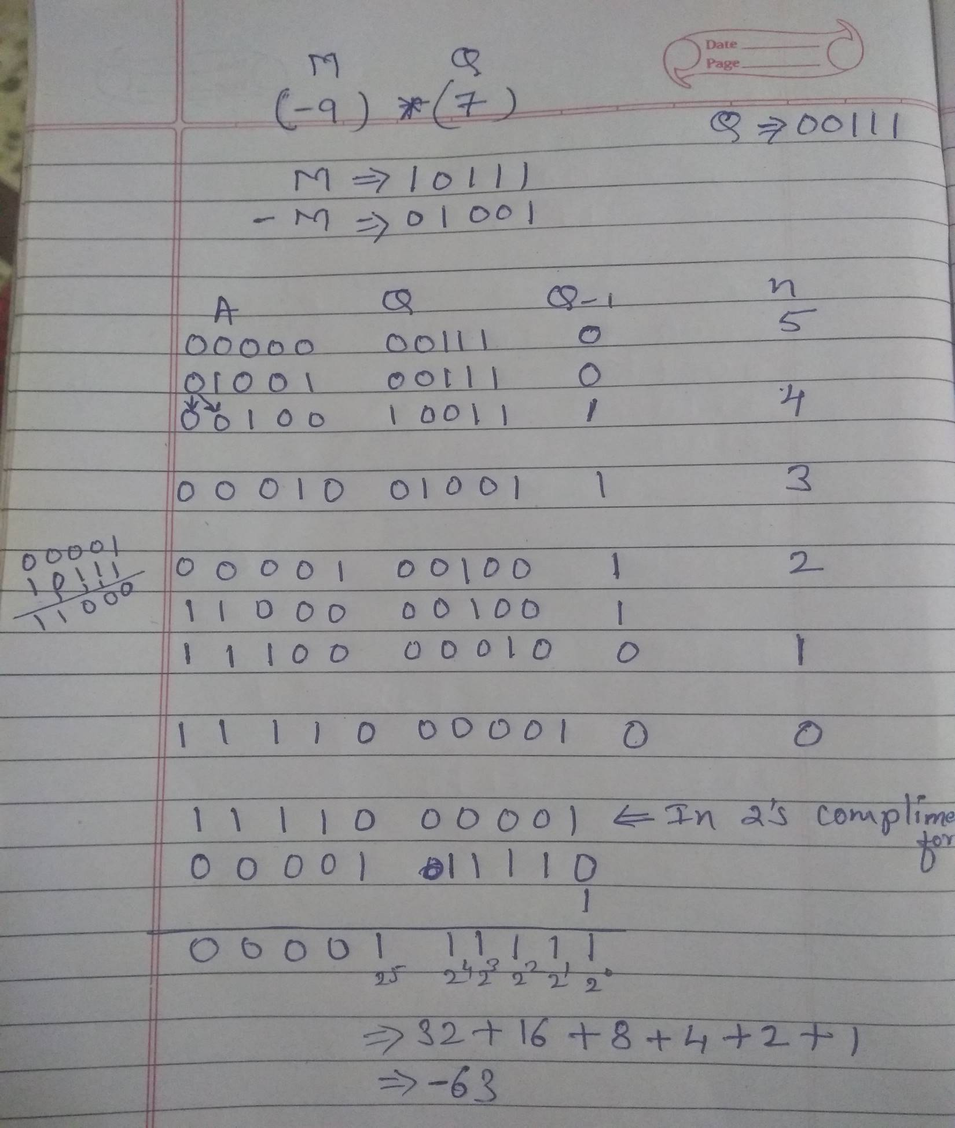

Slide 13
Examples-size of n determines answer
Solve using Booths Algorithm
M = 5 , Q = 5
M = 12, Q = 11
M = 9, Q = - 3
M = -13 , Q = 6
M = -15 , Q= 15
M = -19 , Q = -20
M = -7 , Q = 3
M = 15 , Q = -6
M = -12 , Q = -18
M = -7 , Q = 14

Slide 14
Booths Recoding / Bit pair recording
Booths Recoding / Bit pair recording
Derived from the Booth’s algorithm.
Reduced number of steps
3 steps
Calculate the table of M
Solve for reduced value of Q
for 01=+1
10=-1
00/11=0
3. Perform M*Q

Slide 15
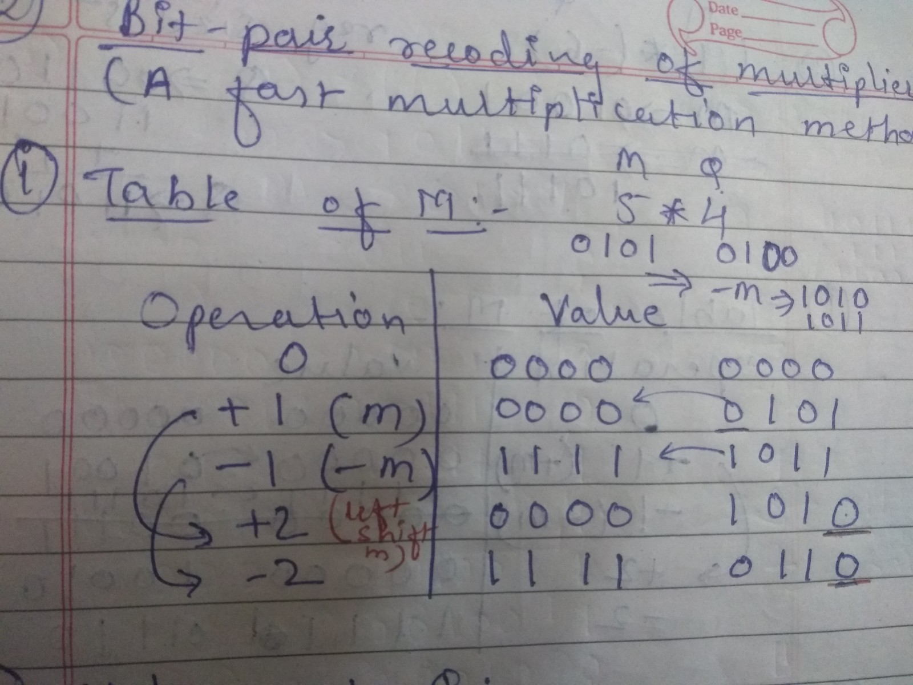

Slide 16
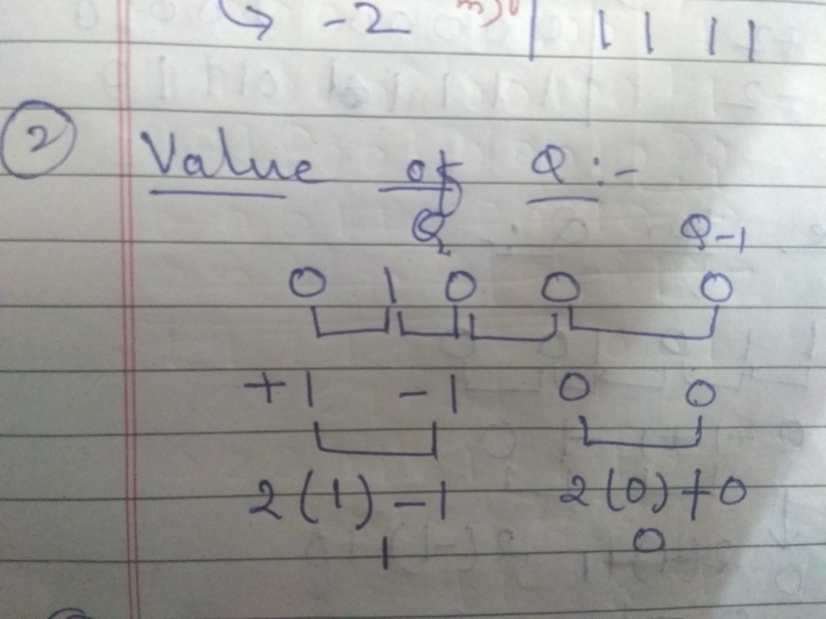

Slide 17
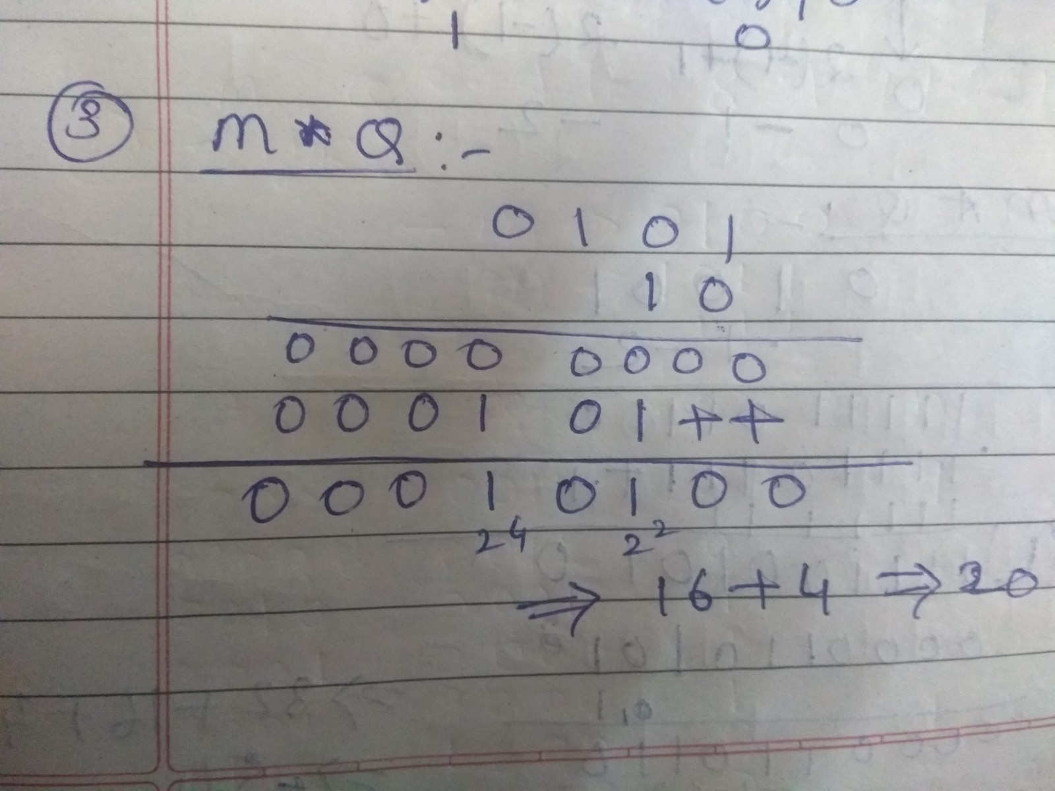

Slide 18
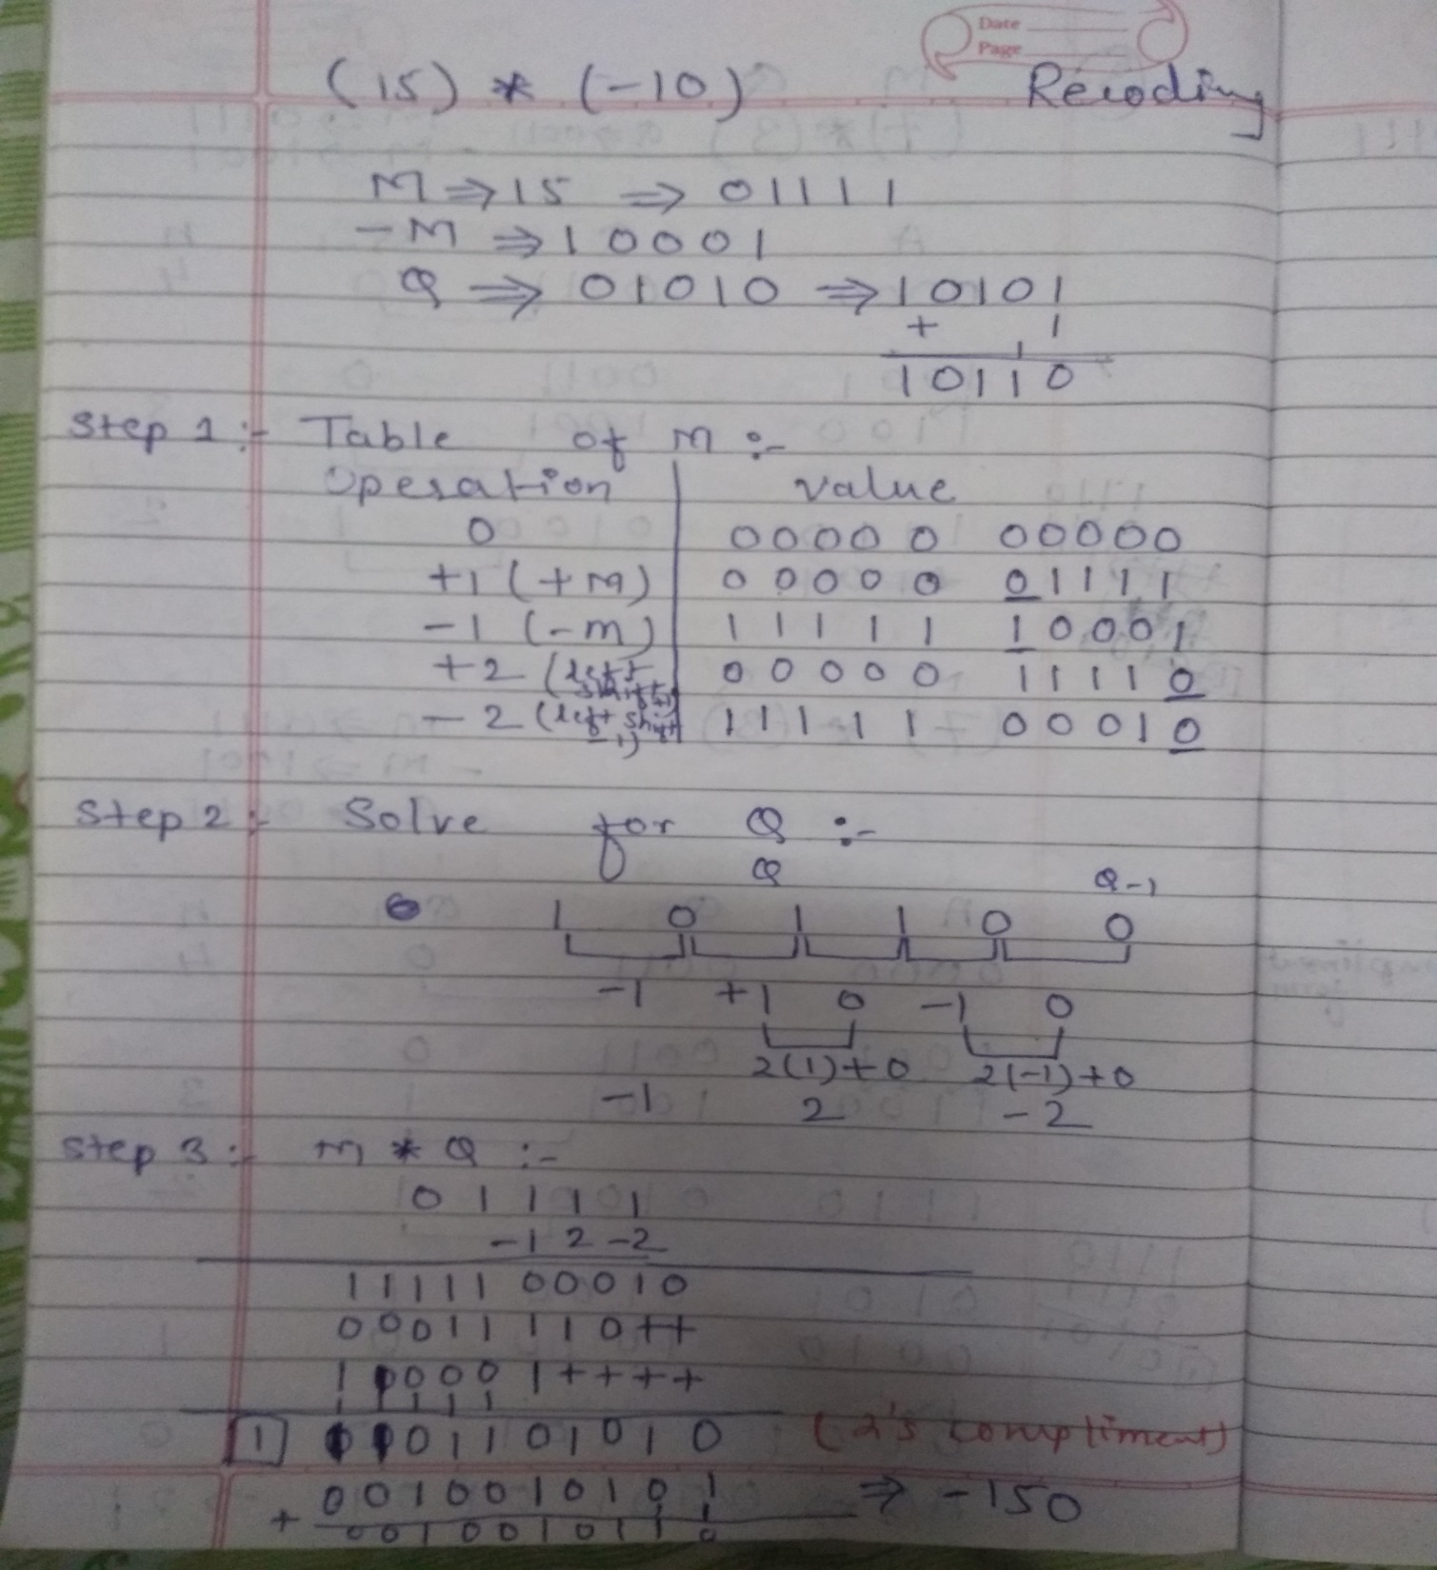

Slide 19
Booths Recoding / Bit pair recoding
Solve Booth’s Recoding algorithm
1. M = 9 , Q = -6 (take 5 bits)
2. Implement multiplication of the following pair of signed 2’s complement numbers using bit-pair recoding.
M=110011
Q=101100
i.e. numbers are -13 * -20

Slide 20
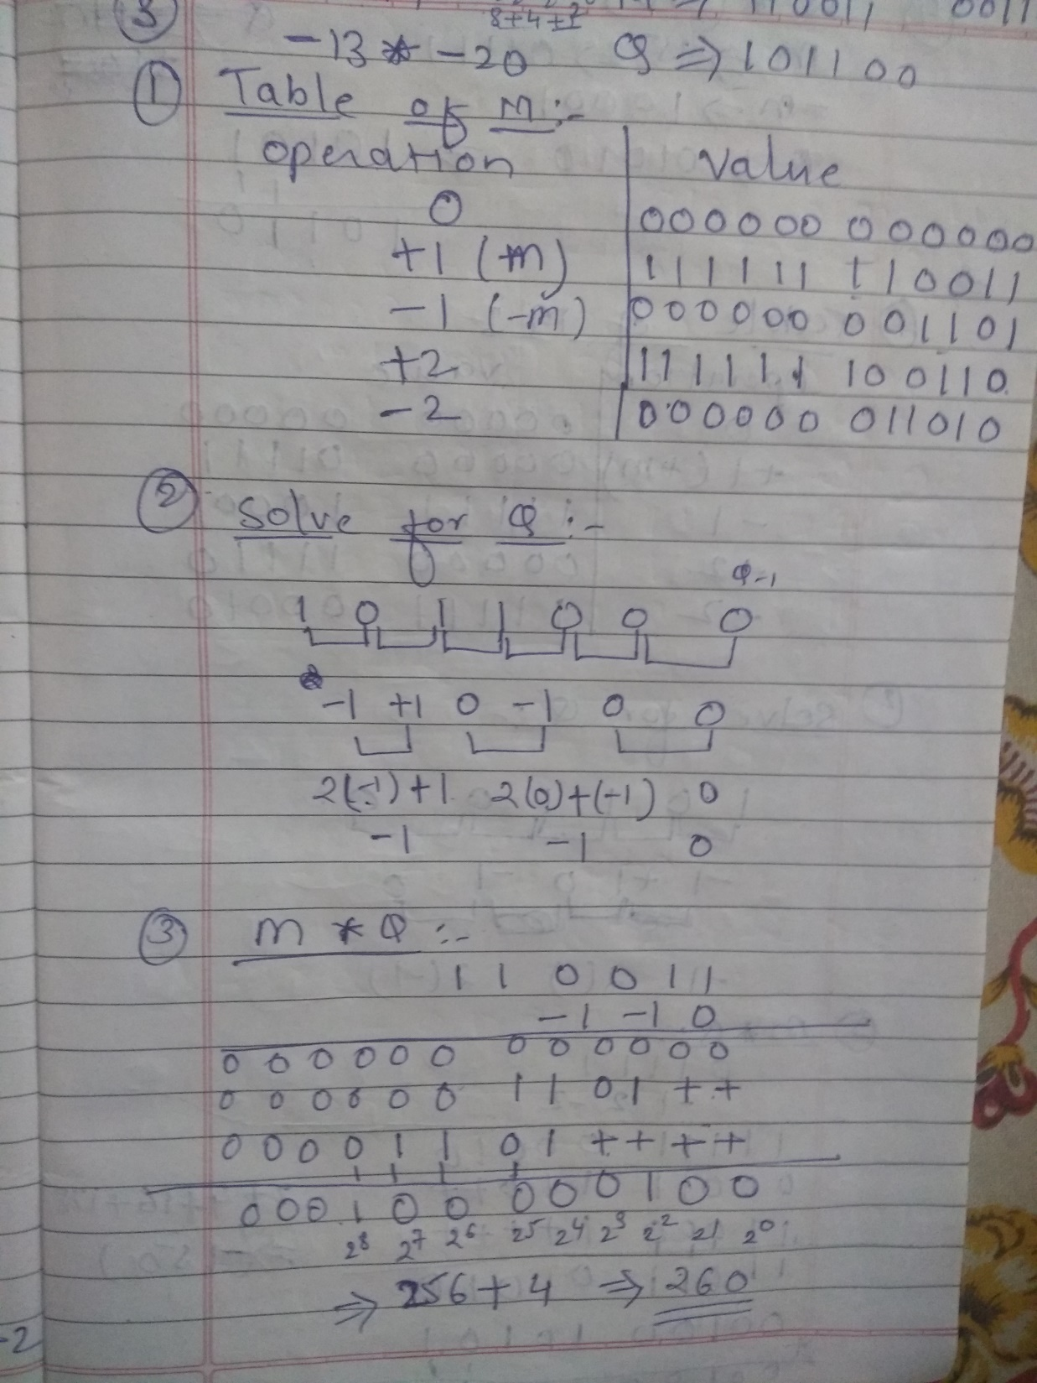

Slide 21
Division
More complex than multiplication
Negative numbers are really bad!
Based on long division

Slide 22
Division of Unsigned Binary Integers
00001101
Quotient
Divisor
1011
10010011
Dividend
1011
001110
Partial
Remainders
1011
001111
1011
Remainder
100

Slide 23
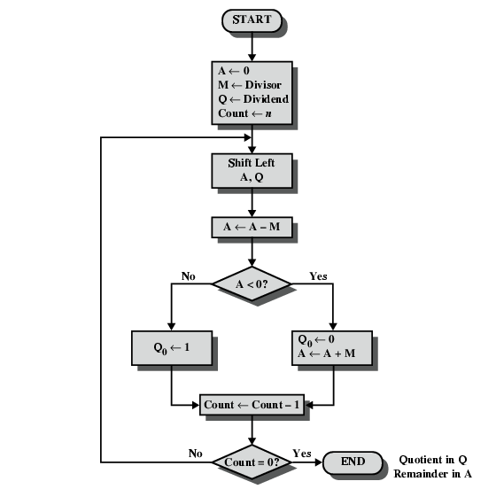
Flowchart for Restoring Division

Slide 24
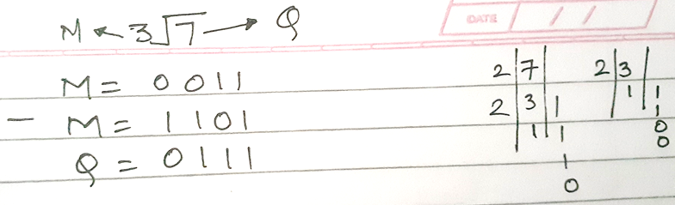
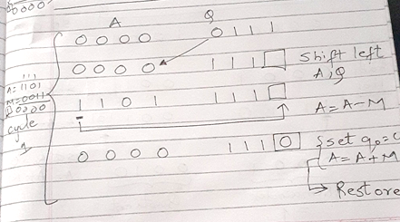

Slide 25
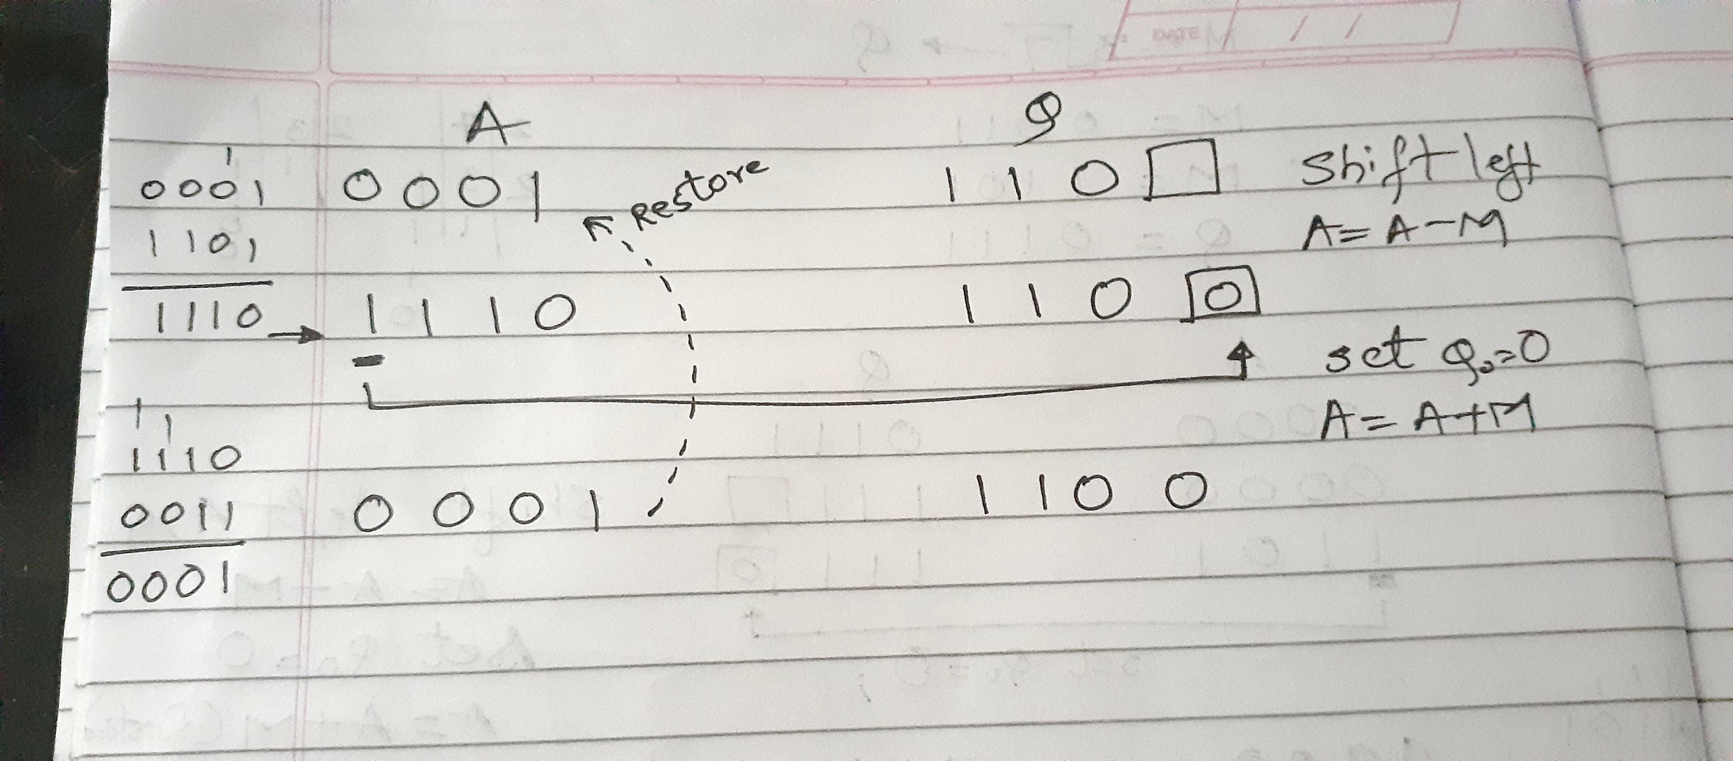

Slide 26
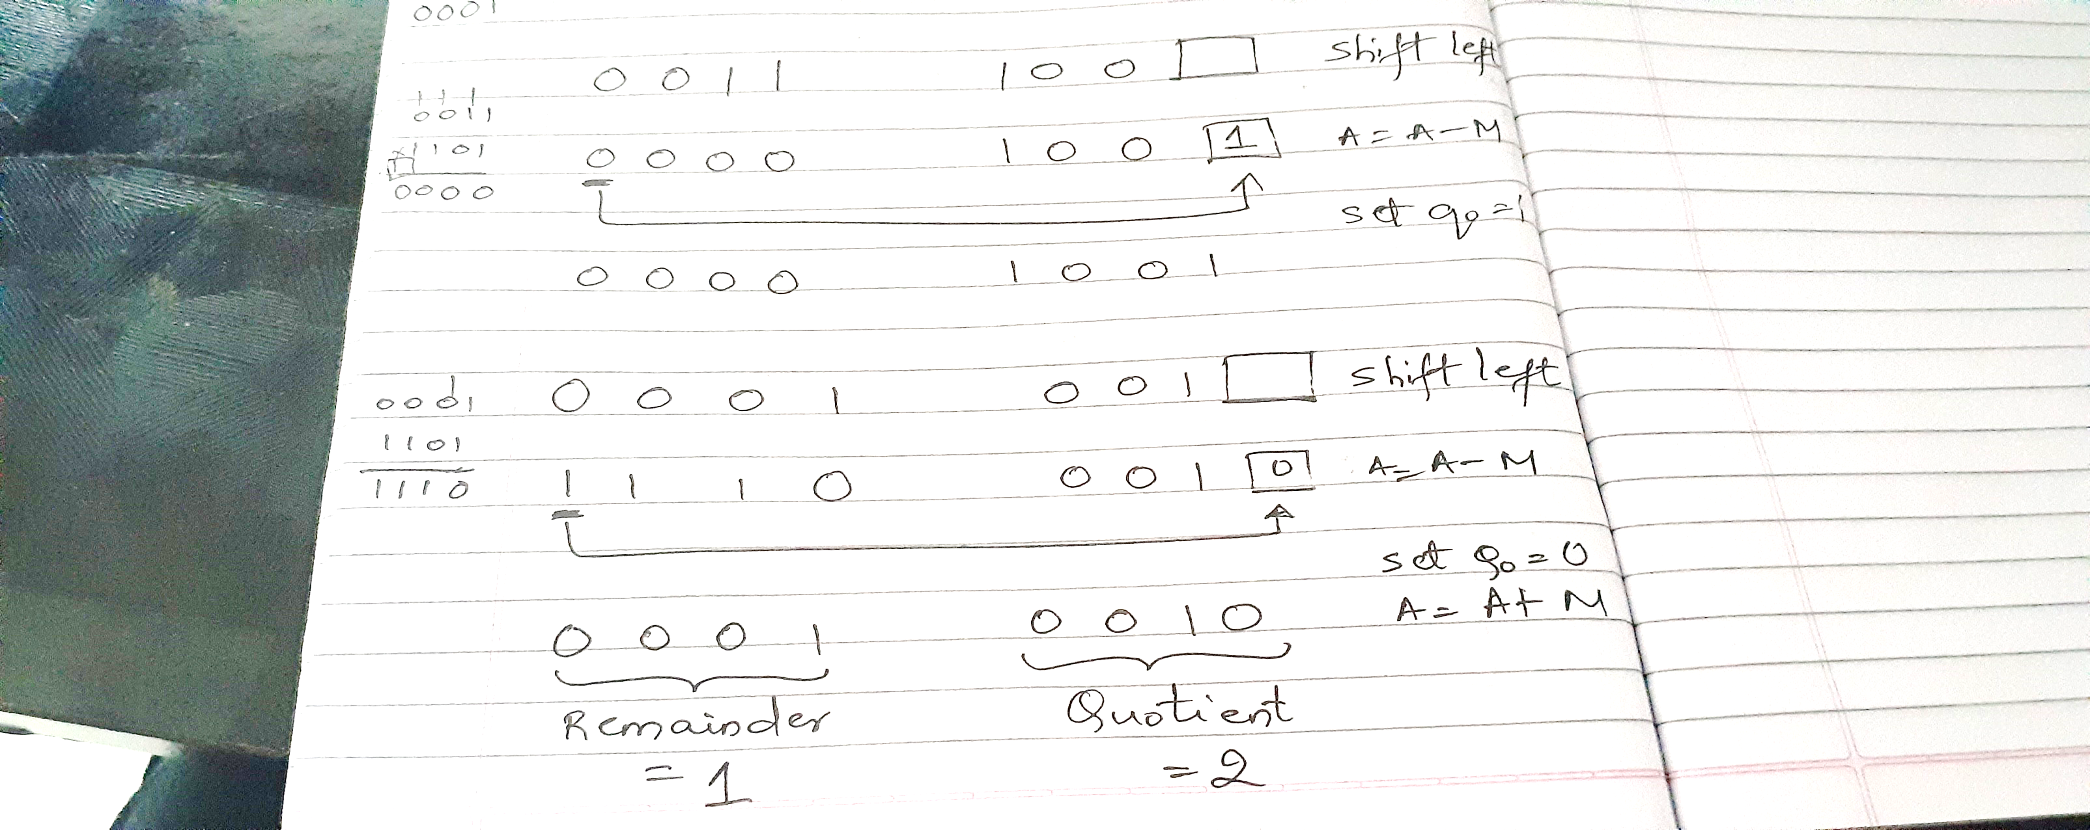

Slide 27
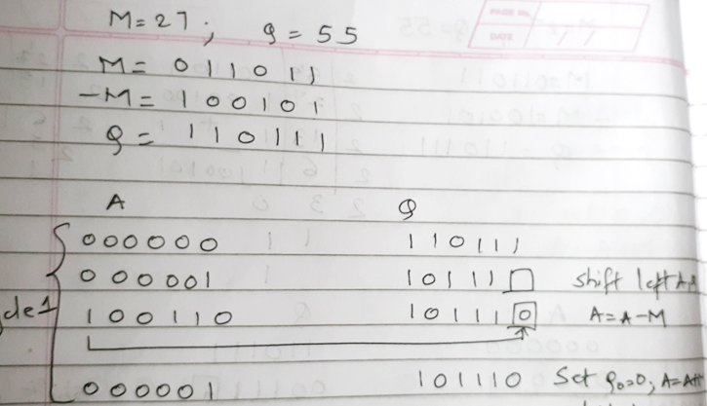

Slide 28
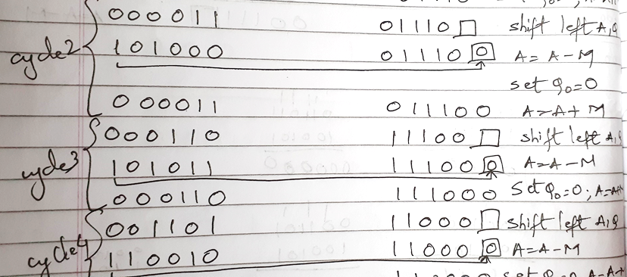

Slide 29
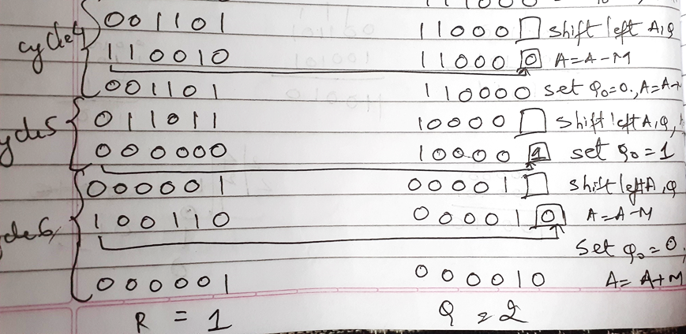

Slide 30
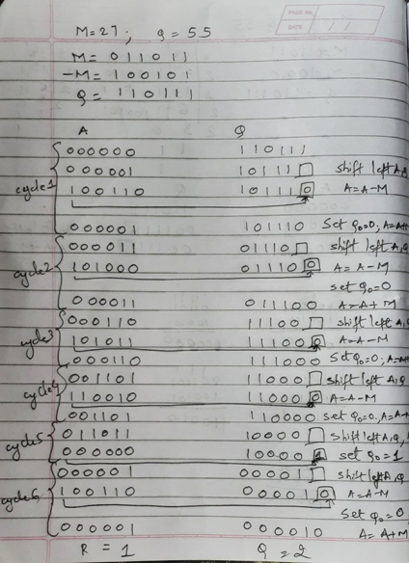

Slide 31
Solve using Restoring Division
M = 5 , Q = 5
M = 12, Q = 26
M = 9, Q = 19
M = 32 , Q = 59
M=27 , Q=55
M = 17 , Q = 42

Slide 32
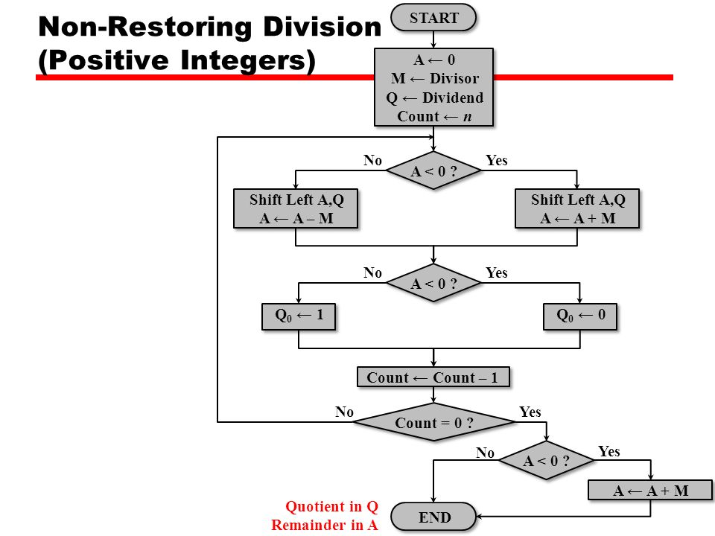

Slide 33
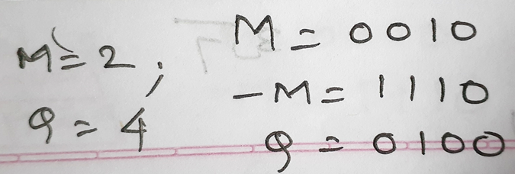
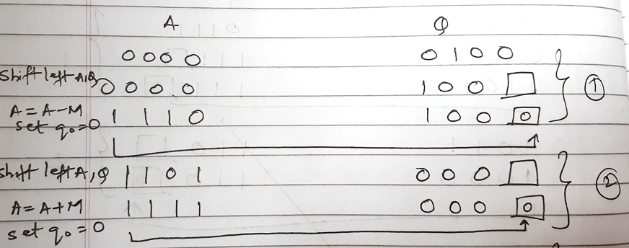

Slide 34
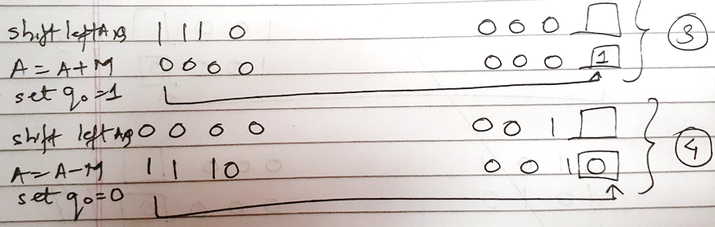
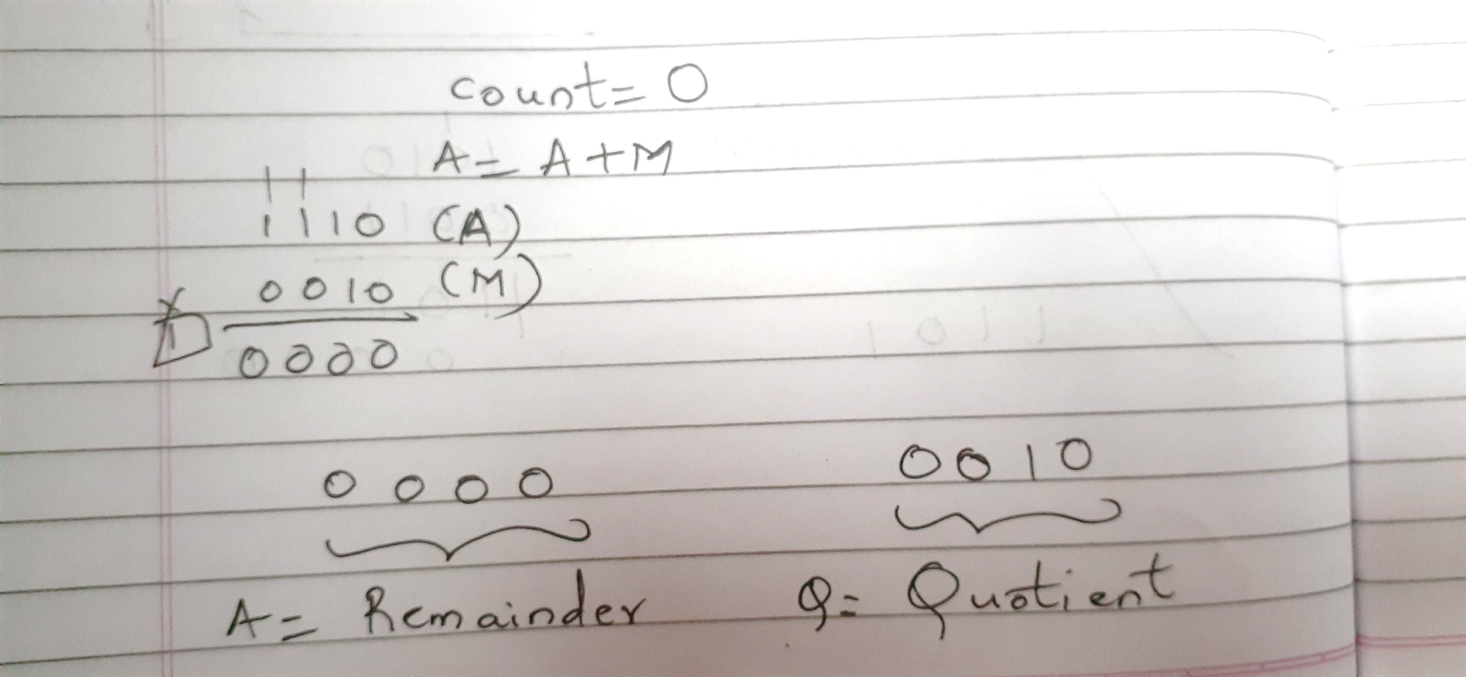

Slide 35
Solve using Non Restoring
M = 5 , Q = 5
M = 12, Q = 26
M = 9, Q = 19
M = 32 , Q = 59
M = 17 , Q = 42

Slide 36
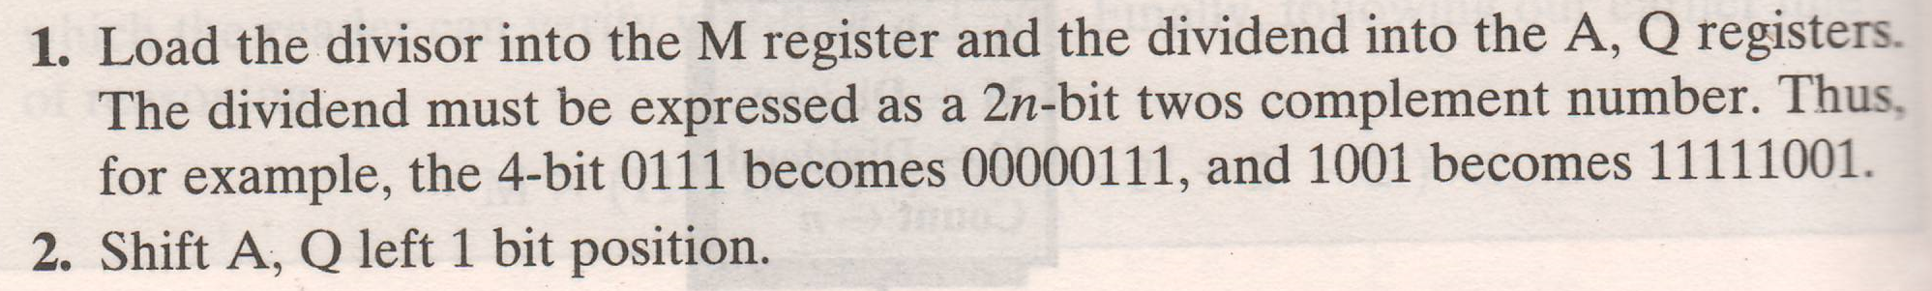
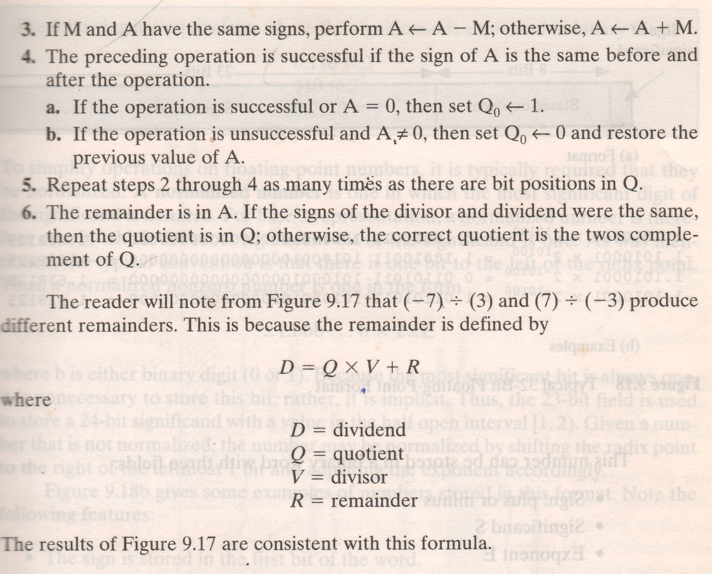
Division of signed numbers

Slide 37
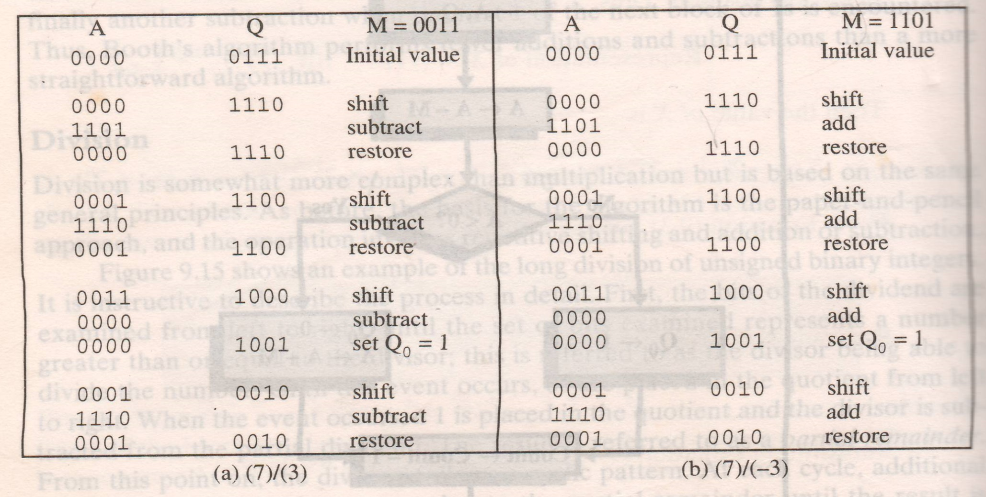

Slide 38
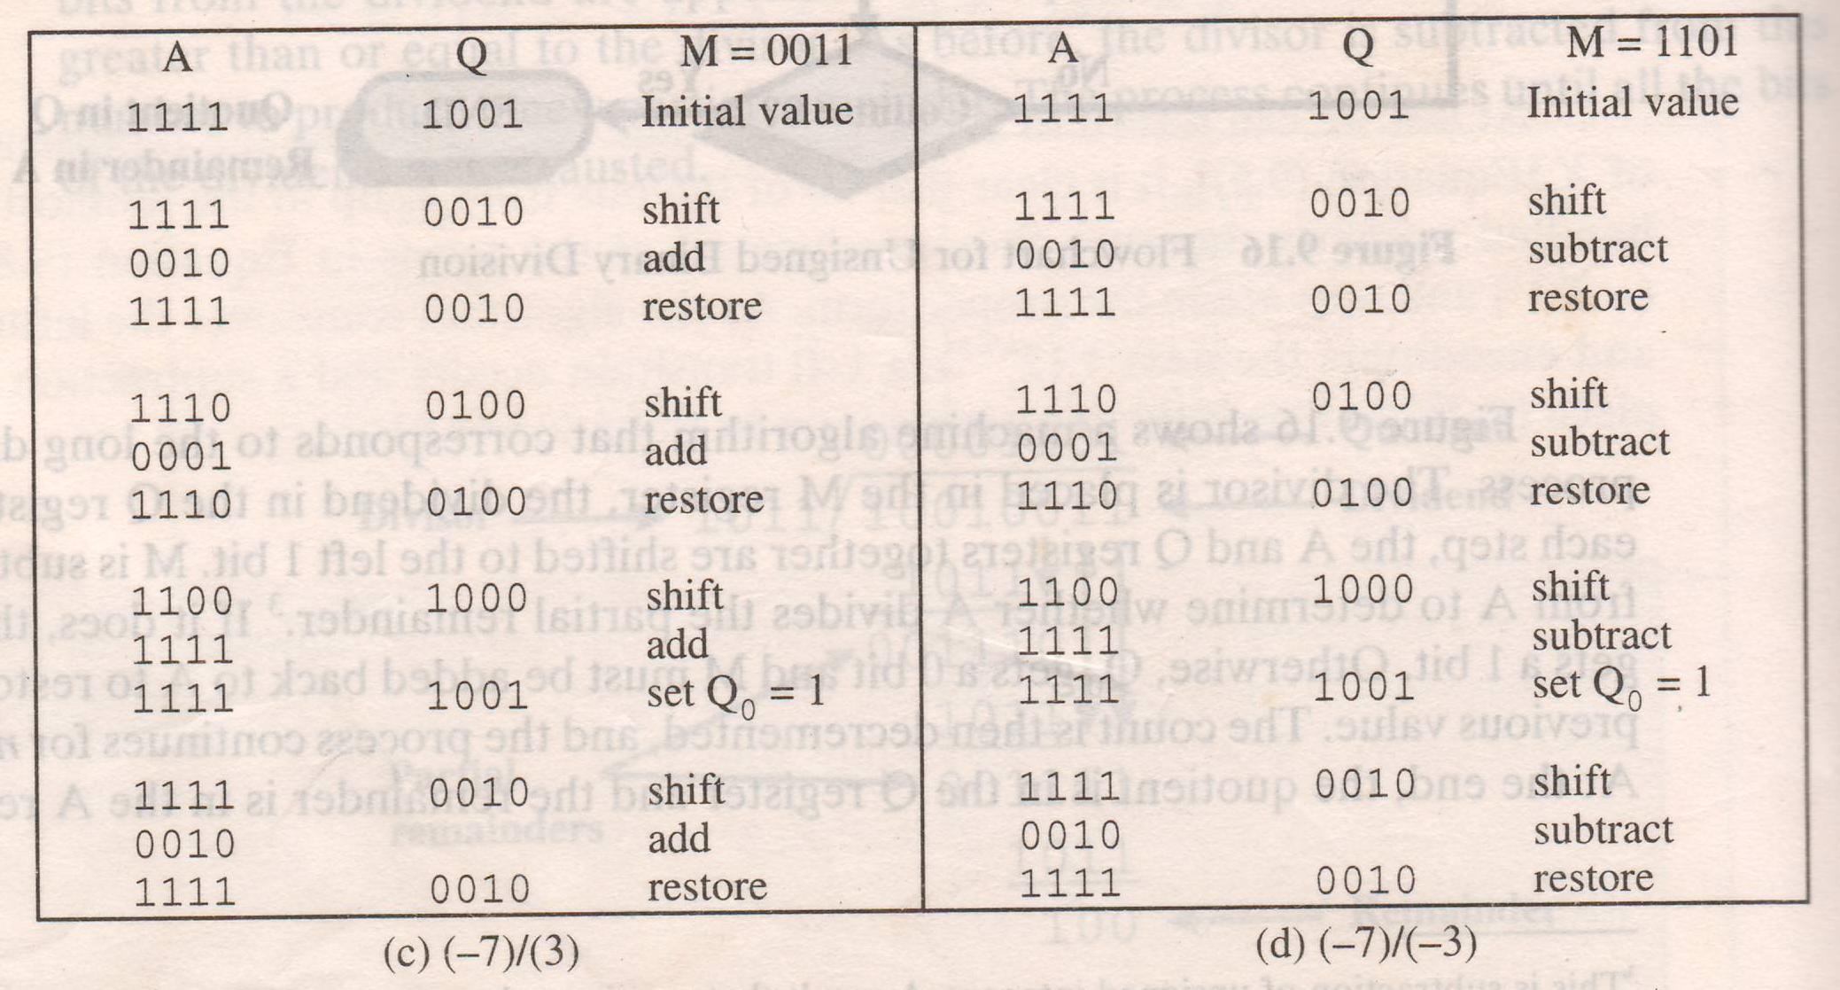

Slide 39
Floating Point
IEEE Standard 754 floating point is the most common representation today for real numbers on computers, including Intel-based PC's, Macs, and most Unix platforms.
IEEE, stands for the Institute of Electrical and Electronics Engineers.

Slide 40
Floating Point
Sign bit
Biased
Exponent
Significand or Mantissa
+/- .significand x 2^{exponent}
Point is actually fixed between sign bit and body of mantissa
Exponent indicates place value (point position)
E.g. 2.5*2^5

Slide 41
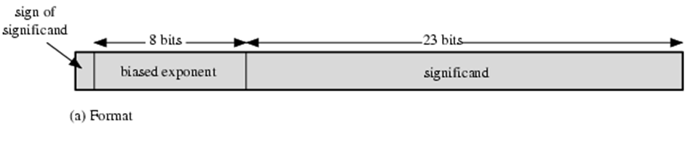
Floating Point Examples

Slide 42
Signs for Floating Point
Mantissa is stored in 2s compliment
Exponent is in excess or biased notation
e.g. Excess (bias) 128 means
8 bit exponent field
Pure value range 0-255
Subtract 128 to get correct value
Range -128 to +127

Slide 43
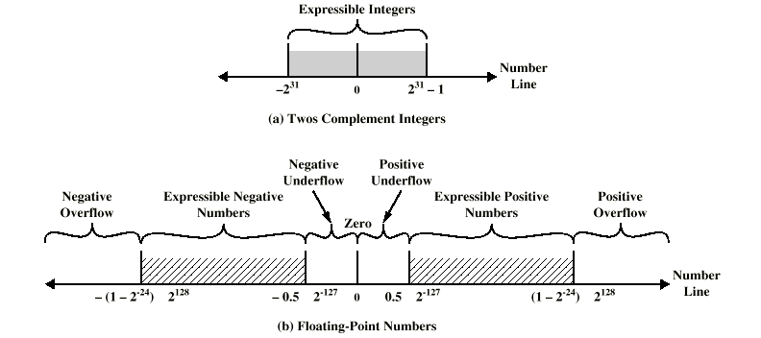
Expressible Numbers

Slide 44
IEEE 754
Standard for floating point storage
32 and 64 bit standards
8 and 11 bit exponent respectively
Extended formats (both mantissa and exponent) for intermediate results

Slide 45
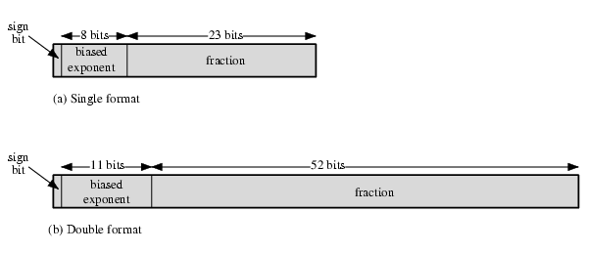
IEEE 754 Formats
(1.N)2^{E-127}
32 BIT
64 BIT
(1.N)2^{E-1023}

Slide 46
Steps
1. Convert Decimal to Binary
2. Normalization
Rewriting Step 1 into (1.N) form
Ex: 1 1 1 . 0 1 1 = 1 . 1 1 0 1 1 X 2 ² Exponent
Ex: 0 . 0 0 0 1 0 = 0 0 0 0 1 . 0 X 2 -⁴
3.Biasing
Applying Single Precision (E – 1 2 7) & Double Precision ( E – 1 0 2 3 ) on exponent from Step 2
4. Representation in Single (32 bit )and Double Precision (64 bit ) Format

Slide 47
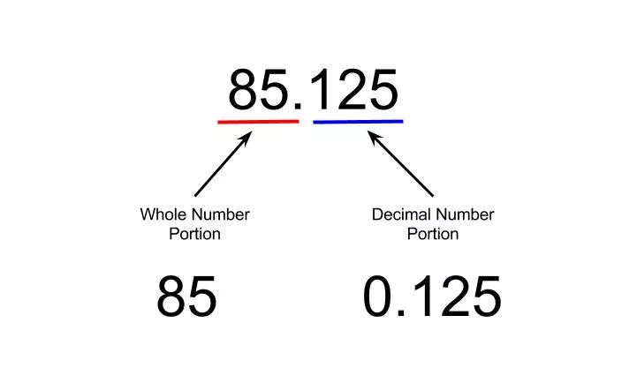
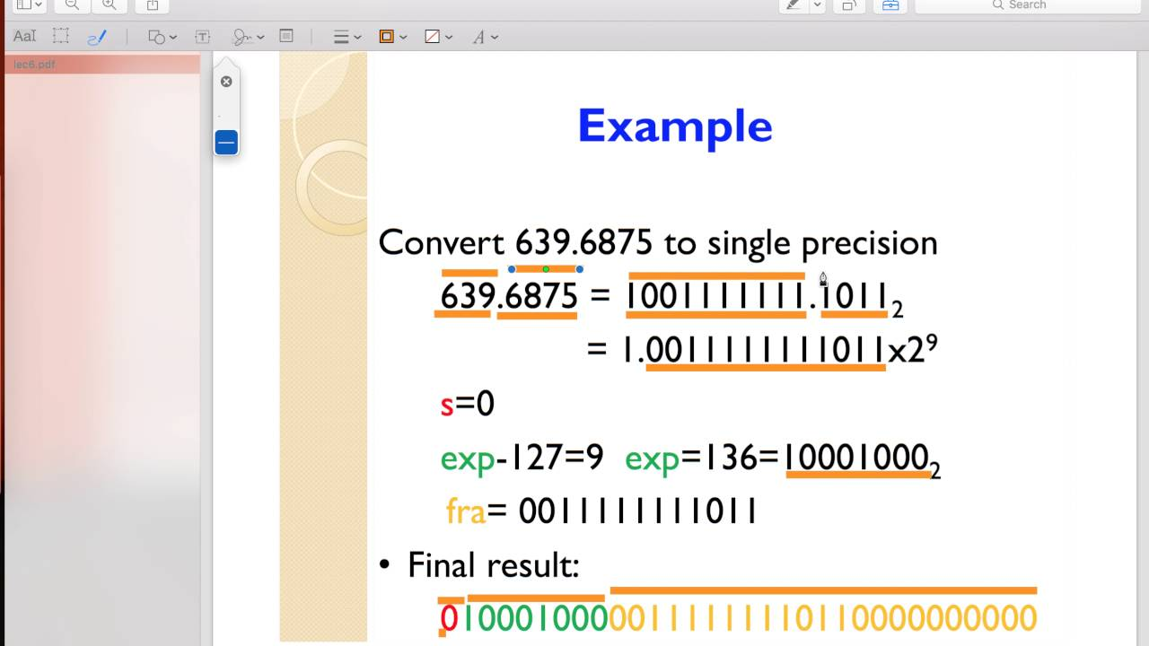

Slide 48
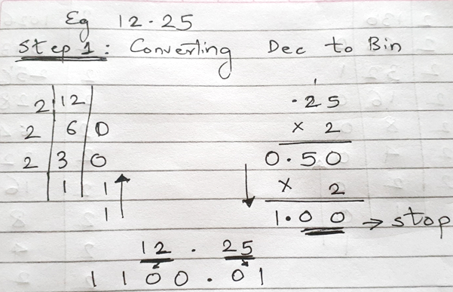
Solved Example

Slide 49
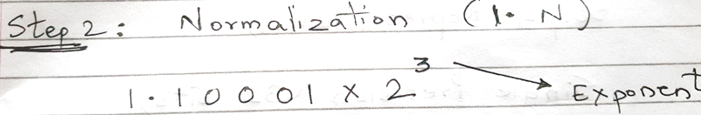
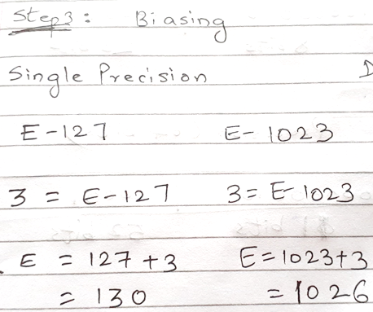
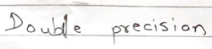

Slide 50
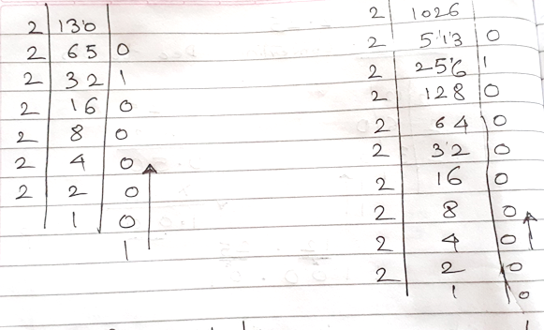

Slide 51
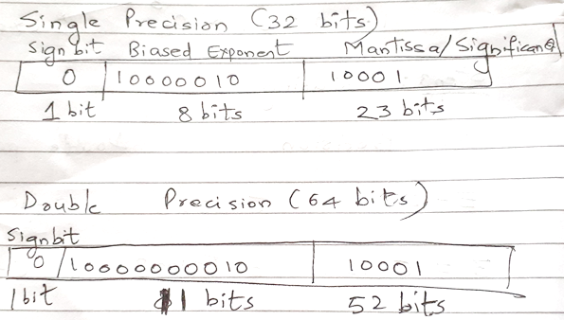

Slide 52
Solve
25.44
178.1875 Single precision: 0 10000110 01100100011
Double precision: 0 10000000110 01100100011
-309.1875 Single precision: 1 10000111 001101010011
Double precision: 1 10000000111 001101010011
0.00635
-125.10
13.54 Single precision: 0 10000100 10110001010001111010111
Double precision: 0 10000000011 10110001010001111010111

Slide 53
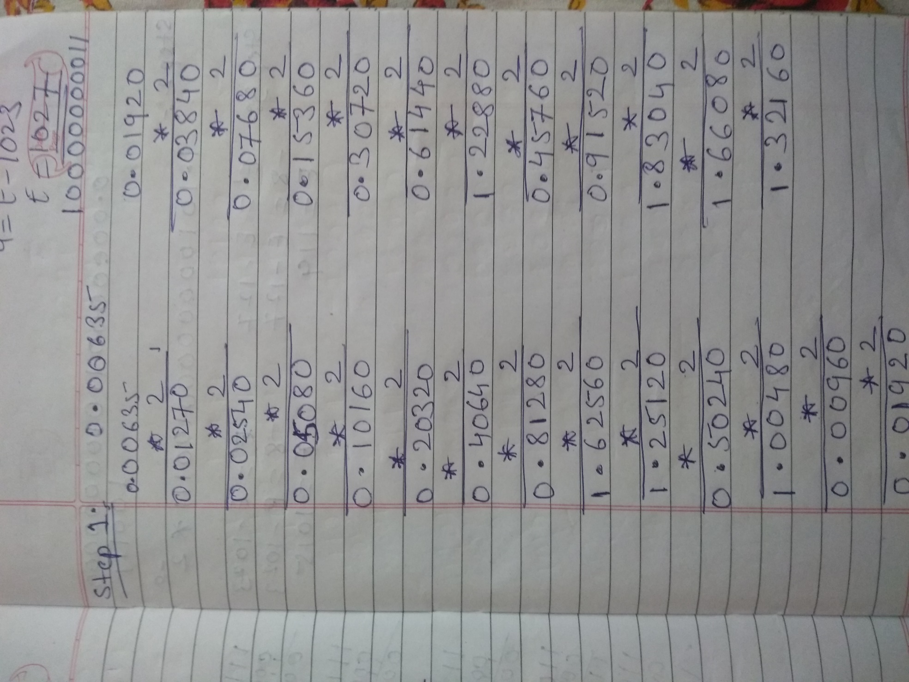
Solve 0.00635

Slide 54
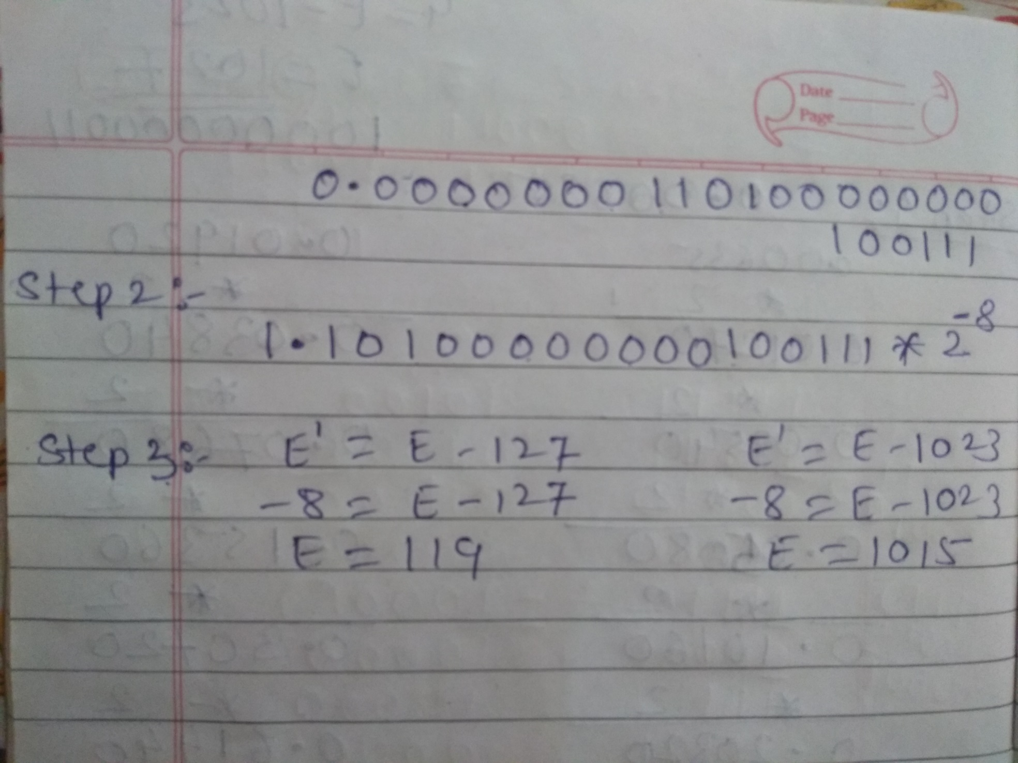
Solve 0.00635

Slide 55
FP Arithmetic +/-
Check for zeros
Align significands (adjusting exponents)
Add or subtract significands
Normalize result

Slide 56
Floating Point Addition
Add the following two decimal numbers in scientific notation:
8.70 × 10⁻¹ with 9.95 × 10¹
Rewrite the smaller number such that its exponent matches with the exponent of the larger number.
8.70 × 10⁻¹ = 0.087 × 10¹

Slide 57
Add the mantissas
9.95 + 0.087 = 10.037 and
write the sum 10.037 × 10¹
Put the result in Normalised Form
10.037 × 10¹ = 1.0037 × 10²
(shift mantissa, adjust exponent)

Slide 58
Check for overflow/underflow of the exponent after normalisation
Overflow
The exponent is too large to be represented in the Exponent field
Underflow
The number is too small to be represented in the Exponent field

Slide 59
Round the result
If the mantissa does not fit in the space reserved for it, it has to be rounded off.
For Example: If only 4 digits are allowed for mantissa
1.0037 × 10² ===> 1.004 × 10²

Slide 60

FP Addition & Subtraction Flowchart

Slide 61
FP Arithmetic x/÷
Check for zero
Add/subtract exponents
Multiply/divide significands (watch sign)
Normalize
Round
All intermediate results should be in double length storage

Slide 62

Floating Point Multiplication

Slide 63

Floating Point Division

Slide 64
Example addition in binary Perform 0.5 + (-0.4375)
0.5 = 0.1 × 2⁰ = 1.000 × 2⁻¹ (normalised)
-0.4375 = -0.0111 × 2⁰ = -1.110 × 2⁻² (normalised)
Rewrite the smaller number such that its exponent matches with the exponent of the larger number.
-1.110 × 2⁻² = -0.1110 × 2⁻¹
Add the mantissas:
1.000 × 2⁻¹ + -0.1110 × 2⁻¹ = 0.001 × 2⁻¹
Normalise the sum, checking for overflow/underflow:
0.001 × 2⁻¹ = 1.000 × 2⁻⁴
-126 <= -4 <= 127 ===> No overflow or underflow
Round the sum:
The sum fits in 4 bits so rounding is not required
Check: 1.000 × 2⁻⁴ = 0.0625 which is equal to 0.5 - 0.4375

